Slide 1
Knowledge Mining with Azure Cognitive Search
Randy Thurman
Advanced Analytics and Artificial Intelligence
Cloud Solution Architect
12/1/2020
Microsoft Confidential

Slide 2
Azure AI
AI apps & agents
Knowledge mining
Machine learning
Azure Bot Service
Azure Cognitive Services
Azure Cognitive Search
Azure Databricks
Azure Machine Learning
Azure AI infrastructure
Notes:
Intro: AI is driving transformation across industries and empowering companies to think about their business and how they engage with their customers in completely new ways. Today I’ll be sharing with you how one of our key solution areas, Knowledge Mining, can help you get tangible benefits for your business.

Slide 3
What is knowledge mining?
Unlock valuable information lying latent in all your content in order to perform an action or make decisions
Form 5471
Your documents
Notes:
The knowledge mining solution area focuses on this core challenge. Innovations across vision, speech, language, knowledge, and search mean for the first time it’s possible for our applications to interpret unstructured data in a human-like fashion, and to more deeply understand traditional data in the form of text.
Together, search and AI create a unique solution for finding value in your data– in the end helping to help engage customers, transform products, empower employees and improve operations.

Slide 4
How it works: Cognitive Search Architecture
Notes:
an AI-first approach to content understanding. Cognitive Search is powered by Azure Search with built-in Cognitive Services. It pulls data from a variety of Azure data sources and applies a set of composable cognitive skills which extract knowledge. This knowledge is then organized and stored in a search index enabling new experiences for exploring the data.
Finding latent knowledge in all data
Real-world data is messy. It often spans media types (e.g. text documents, PDF files, images, databases), changes constantly, and carries valuable knowledge in ways that is not readily usable. In our team we see the same challenges that emerge from this on a daily basis: our customers apply information retrieval solutions, such as Azure Search- combined with AI models, either pre-built models such as Cognitive Services or custom ones, to extract latent knowledge in their vast data stores.
The typical solution pattern for this is a data ingestion, enrichment and exploration model. Each of these brings its own challenges to the table—from large scale change tracking to file format support, and even composition of multiple AI models. Developers can do this today, but it takes a huge amount of effort, requires branching into multiple unrelated domains (from cracking PDFs to handling AI model composition), and distracts from the primary goal. This is where Cognitive Search comes in.
When you use Azure Search, you get direct support for each aspect of the process:
Ingest: pull data from Azure Blob Storage, SQL DB, CosmosDB, MySQL, and Table Storage. For unstructured data in Blob Storage, the service not only reads the raw data but also supports extracting contents from several popular file formats such as PDFs and Office documents. The service supports change detection to keep up with changes through incremental processing, without having to go over the entire data set after initial ingestion.
Enrich: use cognitive skills to augment data as it’s ingested using a powerful composition system. The service integrates with Cognitive Services to offer built-in support for OCR (for print and handwritten text), named entity recognition, key phrase extraction, language detection, image analysis with scene description/tagging capabilities, and more. We also included a webhook-based extensibility mechanism that allows you to add your own cognitive skills while fitting into the rest of the picture for ingestion and composition; custom skills are easy to build as Azure Functions or other tools that can expose webhooks. Knowledge created during enrichment often not only augments individual data items, but also connects entities and facts across different items, different stores and even different media types.
Explore: the outcome of enrichment is additional knowledge derived from the ingested data combined with the outcome of applying various AI models to it. Different applications will want to surface different exploration experiences over this data. The original data and all annotations produced during enrichment are put in an Azure Search index—a powerful data store that supports keyword search, understands 56 languages, handles structured queries in addition to unstructured search, and offers faceted navigation. Best of all, the index processes all of this at lightning-fast speeds.

Slide 5
Cognitive Skills within Cognitive Search
Built-in skills
Custom skills
Key Phrase extraction
Location entity extraction
Sentiment analysis
Your custom skill goes here!
Organization entity extraction
Persons entity extraction
Language detection
Face detection
Celebrity recognition
Image tag extraction
Text Utilities
Landmark detection
text recognition
Azure Databricks
Azure Machine Learning
Machine Learning VMs

Slide 6
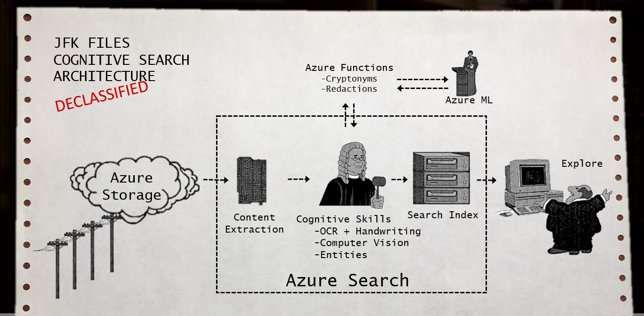
Easily and quickly integrate AI
Cognitive services extract more knowledge from your data
With one-click enable built-in vision and language APIs, and with a few lines of code integrate additional cognitive services
Vision
Language
Speech
Face detection
Tag extraction
Celebrity recognition
Key phrase extraction
Language detection
Sentiment analysis
Location entity extraction
Text to speech
Speech to text
Speech translation
Notes:
Integrating AI is the way that you can extract more insights from your information. For example, vision AI services help from faces to feelings, to understand images and video in your information. Language APIs process text and learn how to recognize what users want. Knowledge services tap into rich knowledge amassed from the web, academia, or your own data.
In order to deeply understand your information, we’ve connected all the pre-built cognitive services from Microsoft and made them available in this service. Enabling vision and language cognitive services like face detection and key phrase extraction are just a click of a button in the Azure Portal. And, you can leverage any of Microsoft’s Cognitive Services through a few steps.

Slide 7
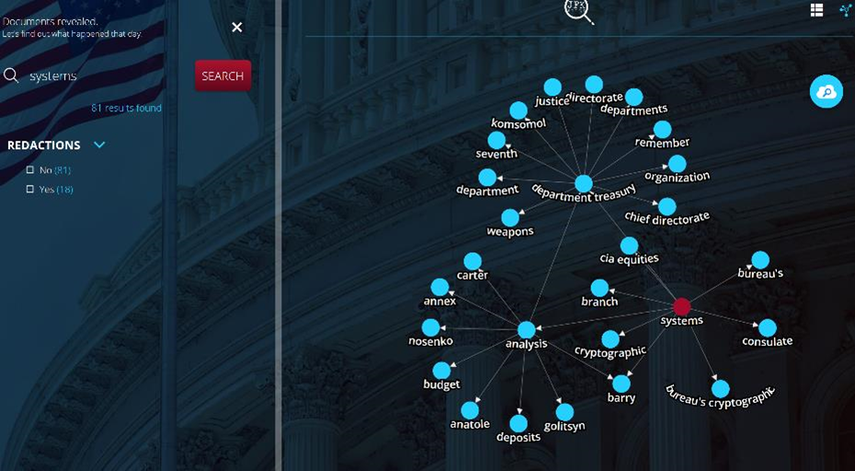
Knowledge mining Demo
JFK Files:
https://jfk-demo.azurewebsites.net/#/
Notes:
Let’s spend some time exploring a final solution that is powered by Azure Cognitive Search:
[click to JFK file demo]

Slide 8
Next steps
Sign up for a free Azure trial:
https://azure.microsoft.com/en-us/free/
The landing page for JFK Files Demo:
https://www.microsoft.com/en-us/ai/ai-lab-jfk-files
Download and deploy the code:
https://github.com/Microsoft/AzureSearch_JFK_Files
Detailed architecture:
https://docs.microsoft.com/en-us/azure/architecture/solution-ideas/articles/cognitive-search-with-skillsets
Power Skills Library:
https://github.com/Azure-Samples/azure-search-power-skills
Knowledge Mining Accelerator:
https://github.com/Azure-Samples/azure-search-knowledge-mining

Slide 9
Questions?
Notes:
We’ll dive a little deeper into how Icertis made their solution possible. Icertis is a Microsoft partner that’s leading the way in digitizing contracts. Azure Cognitive Search allows them to ingest contracts, extract content, and then find meaning through out of the box services as well as custom models. By helping companies better understand and manage their contractual obligations, Icertis & Azure Cognitive Search helps improve compliance, reduce risk, and streamline operations. Let’s walk through how they made it possible.

